Slide 1


Working with Men
Coercive Control
Presented by Mark Walters, QCDFVR
M: PO Box 135, Mackay MC, Qld 4741
P: 07 4940 3320 E: m.s.walters@cqu.edu.au
www.noviolence.org.au

Slide 2


Drawing information from research and publications;
Brown, B. (2012) Daring Greatly; How the Courage to be Vulnerable Transforms the way we Live, Love, Parent and Lead. Gotham Books N.Y.
Department for Child Protection and Family Support. ( 2013). Practice Standards for Perpetrator Interventions; Engaging and Responding to Men who are Perpetrators of Family and Domestic Violence. Perth Westerns Australia. W.A. https://www.dcp.wa.gov.au/CrisisAndEmergency/FDV/Documents/2015/PracticeStandardsforPerpetratorIntervention.pdf
Domestic and Family Violence Death Review and Advisory Board 2016 -17 Annual Report. (2017) Queensland Government, Brisbane.
Kelly, L., & Westmarland, N. (2016) Steps Towards Change. Project Mirabal Final Report. Durham University.
Murphy, C. (2014) Tactics of Coercive Control Used by Men Against Intimate Female Partners. www.speakoutloud.net
Polaschek, D.L.L. (2016) Responding to Perpetrators of Family Violence. New Zealand Family Violence Clearinghouse.
Valis, R. (2014) Domestic Violence Perpetrator Programs; Education, Therapy, Support, Accountability or Struggle? No to Violence; Male Family Violence Prevention Association.
Valis, R., Ridley, S., Green, D., & Chung, D. (2017). Family and Domestic Violence Perpetrator Programs. Issues Paper of Current and Emerging Trends, Developments and Expectations. Stopping Family Violence Inc.

Slide 3
And from my (and others) practice experience and professional development.

Slide 4
Integrated service responses.. (IRS)
“ critical to building a system is commitment by DFV specialist agencies, mainstream agencies with a key role in FDV (such as police and child protection), and by agencies that often have men using violence attending the service but which do not address this issue directly or intensively, to ask questions about DFV, assess risk, share information and offer consistent pathways to addressing men’s use of violence”. Valis, R., Ridley, S., Green, D., & Chung, D. (2017) page 4.

Slide 5
Clarity of analysis is also fundamental to a integrated service response.
“the need to start from a an understanding of coercive control and entrapment patterns rather than incident based focus is not new to specialists women and men’s DFV service providers. The problem arises when other elements of the integrated response system focus on incidents, thereby shaping expectations concerning referral criteria, program design and what counts as successful outcomes..” Valis et al (2017) page 18

Slide 6
We are all educators; we all have spheres of influence. It is in those spheres of influence whether formal learning environments, social media posts or lunch room discussions, the notion of clarity of analysis, is to me, very important.

Slide 7
“framing domestic violence in terms of incidents – whether in research, policy or practice response – reflects how violent men describe their behaviour rather than what we know from survivors.
What women describe is an ongoing ‘everyday’ reality in which much of their behaviour is ‘micro- managed’ by their abuser; this includes what they wear, where they go and who they see, household management and childcare. None of these are ‘incidents’, nor would they be considered crimes”
Kelly, L., & Westmarland, N. (2016) p..114

Slide 8
National Survey on Community Attitudes to Violence Against Women 2013
Sample size of over 17,500 interviewed by phone, the third survey of its kind (1995, 2009). Weighted evenly to account for gender, age, socio economic status and cultural background.
64% perceived the main cause of family violence as some men not being able to manage their anger.

Slide 9
Men aren’t just loosing control…dipping out..
Just as individual men can choose to use violence, they can choose not to; responsibility for this choice is theirs alone;
This understanding is fundamental to supporting women and children, because they will almost certainly have experienced blaming from the perpetrator of the violence, and possibly in the broader community. They might also be inclined toward sharing or accepting the blame out of love or misplaced loyalty toward the perpetrator.
Perpetrator Accountability in Child Protection Practice.
W.A. Department for Child Protection, Family and Domestic Violence Unit; 2013

Slide 10
National Survey on Community Attitudes to Violence Against Women 2013
Sample size of over 17,500 interviewed by phone, the third survey of its kind (1995, 2009). Weighted evenly to account for gender, age, socio economic status and cultural background.
51% of the survey respondents believed that a woman could leave a violent relationship if she really wanted to (54%/2009).
In the 2016 – 17 Annual Report from the Death Review and advisory Board; the lethality risk factor that emerged in 57.4 % of the cases reviewed was..
Actual or pending separation.

Slide 11
Evan Stark defines ‘coercive control’ as harmful and unwarranted control of one human being by another, which is caused by a myriad of small actions.
Cited in Valis et al (2017) p 18.

Slide 12
A set of individualised and specific tactics to exploit existing vulnerabilities or to create new ones through disrupting and destroying confidence, capacity and/or capabilities.

Slide 13
So unlike angry men out of control; calculating abuses get to know their victims, a bit at a time.
They strategize…..
Selective and thoughtful.

Slide 14
Consider the actions involved in gas lighting. Subtle disruptions of routine and order.
Technique needs to match vulnerabilities (or the possibilities of creating one).
One type or tactic doesn’t fit all…

Slide 15
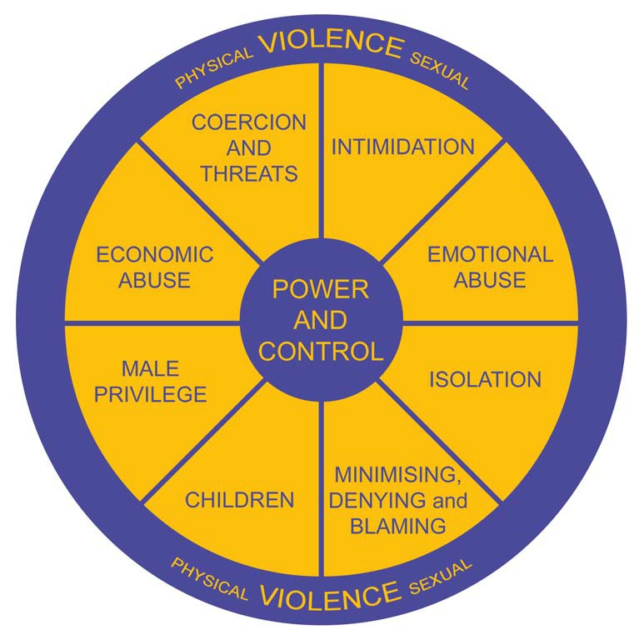

Slide 16
“Sexual violence may serve as an expression of men’s unearned gender-based privilege, based on a belief that they are entitled to sexual gratification and are being ‘victimised’ when women ‘withhold’ sex from them.” (Vlais, 2011)

Slide 17
So what to look for..
Evan Stark again..
Stark deploys the concept to distinguish between severe and non-severe forms of abuse of women, locating the severity in the consequence (control) of the action rather than the action itself. His focus is on the long duration of the consequences rather than the episodic nature of the repeated actions. Cited in Valis et al (2017) p 18.

Slide 18
In the Project Mirabal Final Report measure 2 was Expanded Space for Action which talks to the restoration of freedom that abuse (control) restricts.
“the intent of setting the limits of women’s behaviour serves to limit her space for action and it is this narrowing which many women in the pilot study resented and railed against”.
Kelly, L., & Westmarland, N. (2015) p 15

Slide 19
For most men who perpetrate violence, the journey toward taking responsibility for their violence—and stopping it completely—will be long and complex. For many, it may never be completed. Even with significant support from specialised male family and domestic violence services, many perpetrators do not make sufficient changes to be considered safe parents and contributors to the family environment.
Perpetrator Accountability in Child Protection Practice.
W.A. Department for Child Protection, Family and Domestic Violence Unit; 2013

Slide 20
The idea of engagement is also central to todays discussions as it is the process, I believe, that we move those using violence out of the shadows and inform risk management.
What belief does the behaviour represent; what message?

Slide 21
We can see the methods and the mechanisms to maintain the control but engagement seeks to discover the beliefs behind the abusive behaviours.
a complex, continuing, and evaluative process rather than a static event and it should include an examination of:
static risk factors, and dynamic (changing) factors;
patterns of behaviour;
patterns of violence;
coercive controls; and
beliefs of perpetrators.

Slide 22
Entitlement beliefs..
• If people don’t respect me, I can’t stand it
• I deserve a lot of attention and praise
• I’m superior (and am entitled to special treatment and privileges)
• If I don’t excel, then I’m inferior and worthless
• If I don’t excel, I’ll just end up ordinary
• I am a very special person (and other people should treat me that way)
• I don’t have to be bound by the rules that apply to other people
• If others don’t respect me, they should be punished
• Other people should satisfy my needs
• People have no right to criticize me
• Other people don’t deserve the good things that they get
• People should go out of their way for me
• People don’t understand/get me (because I am special/brilliant/etc.)
• I can do no wrong Dr. Bridgett Ross is a Licensed Clinical Psychologist and owner of Ross Psychology.
http://www.rosspsychology.com/1/post/2011/06/cognitive-therapy-101-core-beliefs.html

Slide 23
Message
your complete loyalty;
“verifiable” faithfulness;
your absolute commitment;
I control everything;
my needs are more important;
you’re useless;
without me, you’d be nothing ;
I an entitled to “everything”;
I’m all you need;
you should be scared.

Slide 24
Message Beliefs
your complete loyalty; If people don’t respect me, I can’t stand it or I deserve a lot of attention and praise.
“verifiable” faithfulness; If others don’t respect me, they should be punished
your absolute commitment; I’m superior (and am entitled to special treatment and privileges)
I control everything; Other people should satisfy my needs
my needs are more important; I am a very special person (and other people should treat me that way)
you’re useless; People have no right to criticize me
without me, you’d be nothing ; Other people don’t deserve the good things that they get
I an entitled to “everything”; People have no right to criticize or challenge me
I’m all you need; People don’t understand/get me (because I am special/brilliant/etc.)
you should be scared. If others don’t respect me, they should be punished

Slide 25
Piece a bit together;
1) She’s saying he is big on “isolating her”. Demands loyalty; big fuss if she wants to see her family. Frequent phoning if she’s out; “keep relationships issues between us”; takes her to and from work Etc.
2) Message is…………… your complete loyalty;
3) Entitlement belief; “I deserve a lot of attention and praise”
4) Now we’d like to ask about that belief. Find the right words…

Slide 26
The message being sent by the skilled practitioner, as I suggested earlier, is the first part of the engagement process.
But that insight needs to be used with care.
Aggression and shame are correlated.
To use that insight and thoughtfulness to tear someone down, just places those at risk, at further harm.

Slide 27
Demonstrate an understanding through the types of questions or reflections.
For example;
“ Would it be fair to say that loyalty is a big deal for you; help me understand why it is so important?”
You have interpreted all his monitoring; stalking; accusing. So instead of talking about the behaviours of a single incident or the impact on her; your asking about the motivating beliefs.
“why is it so important to you?”
So naïve enquiry presents the insights in ways that can foster engagement.

Slide 28
Demonstrate an understanding through the types of questions or reflections.
Why; because it’s a different discussion to be talking about, or designing a referral or case plan, on conversations about values and beliefs.
To talk to or ask about something the perpetrator may feel was hidden or disguised sends important messages.
“I can see you” and I can “see your victim too”.

Slide 29
Demonstrate an understanding through the types of questions or reflections.
If the engagement is establishing, it may lead to discussions of insecurities; betrayals; losses and when the line is drawn it can be hard to dispute…..
“From what you’re telling me, being alone is hard; almost impossible after losing your mother and sister. It sounds like you’re keeping your family hostage to avoid being alone.”

Slide 30
..the key factor in this is the extent to which this work is linked, both conceptually and in practice, to the safety of women and children..
There is a danger that women’s and children’s voices might be lost, if the practitioner doesn’t at least ask:
“ What effect could the work we have done today have on how your partner and kids might experience this coming weekend? Would it be different for them?”
Vlais, R 2014, Domestic violence perpetrator programs: Education, therapy, support, accountability ‘or’ struggle.

Slide 31
Seeing perpetrators of violence as fully responsible for their actions is also critical when attempting to engage them. Any ambivalence on your part might strengthen a man’s violence-supporting narratives, with the risk that he might:
-feel more confident to use violence in the future;
-claim that you are on his side; and
-use your imagined ‘support’ to taunt or otherwise control his (ex)partner and children.
Perpetrator Accountability in Child Protection Practice.
W.A. Department for Child Protection, Family and Domestic Violence Unit; 2013

Slide 32
Demonstrate an understanding through the types of questions or reflections.
We would also acknowledge that in a model where accountability is
See it
Own it
Do something about it.
You can’t be what you cannot see…

Slide 33
On challenging: It may not be necessary, in fact it is detrimental to building rapport to immediately challenge each and every statement that you know to be incongruent. Rather it is prudent to make a mental note and challenge a few examples, perhaps in themes. Forcing him to accept your point of view can be counterproductive.
It is sufficient to state the incongruence and have him hear it.
“Men have to stand up and take on their mates and their family members and tell other men to knock it off. This is about women’s lives and children’s lives.”
(Quote from Our Journal)

Slide 34
Therapeutic alliance
“Now that I have rapport, I will build a logical case for change”.
People do not change because of logic.
People change when they have an emotionally compelling reason to change.
Logic provides the socially acceptable, sensible reason to change; emotion provides the underling motivation to initiate and implement the change.
The currency.

Slide 35
“Men have to stand up and take on their mates and their family members and tell other men to knock it off. This is about women’s lives and children’s lives.”
(Quote from Our Journal)
“You do not have to want to stop your current behaviour in order to change; you simply have to want something else.. more”
Aldo Pucci president of the National Association of Cognitive-Behavioral Therapists

Slide 36
Therapeutic alliance
For counsellors, psychologists and social workers, who do not understand the dynamics of men’s perpetration of violence, run the risk of collusion through violence support narratives.
Without a clear analysis, training and experience, they can focus on issues such as self-esteem, family of origin experiences, anger management or other experiences that focus on healing or addressing psychological issues.
( WA Perpetrator Accountability in Child Protection Practice)

Slide 37
“The victim stance is a powerful one! The victim is always morally right, neither responsible or accountable and forever entitled to sympathy.”
Rethinking 'Don't Blame the Victim': The Psychology of Victimhood ;Ofer Zur, Ph.D
…the most potent contributor to their feelings of “victim stance”, and their feelings of righteous anger, is when their partner, children or others act or fail to act in ways that the man expects, with these expectations being unfair, unjust and fuelled by male entitlement and privilege.. Valis 2014

Slide 38



Constructing gender;
Understanding and combating shame
Expectations are “impossible”.

Slide 39

Constructing gender;
Understanding and combating shame
There is a strong relationship between rigid gender role beliefs and domestic violence. Death review and advisory board annual report 2016 -17
Coercive control includes the micro-regulation of gender in which women are censured for failing to perform the man’s expectation of ‘proper’ femininity. (Stark 2007)

Slide 40
Constructing gender;
Understanding and combating shame
Not allowed to be afraid
Not allowed to show fear
Not allowed to be vulnerable
Shame is being afraid, showing fear or being vulnerable. Strong correlation between shame and aggression. Brown, B 2012

Slide 41
Constructing gender;
Understanding and combating shame
Pissed off or shut down.
… some men learn to develop shame resilience and respond with awareness, self-compassion and empathy.
But without developing that awareness, when men feel the rush of inadequacy and smallness, they normally respond with anger and/or by completely turning off. Brown, B 2012

Slide 42
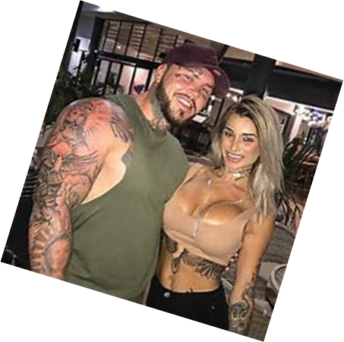

Constructing gender;
Understanding and combating shame
Left to construct gender, expectations are “impossible”. There is a strong relationship between rigid gender role beliefs and domestic violence. Death review and advisory board annual report 2016 -17

Slide 43

Questions; comments; thoughts.
Future contact
m.s.walters@cqu.edu.au

Slide 44

M: PO Box 135, Mackay MC, Qld 4741
P: 07 4940 3320 E: qcdfvronline@cqu.edu.au
www.noviolence.org.au

